Slide 1

What makes great
players great?
Using biometrics to predict NBA success
Lina Barkawi | Jim Green | Scott Halperin | Matt Krasnoff | Jeff Spielberg

Slide 2
Our Goal:
Develop a model to help predict success for NBA prospects based on biometrics

Slide 3
Preview
Data in the NBA
Methodology
Introduction to biometrics - NBA Draft Combine results over time
Player info - Categorial background data on NBA players
How is success measured
Our findings - What leads to success
2018 NBA Draft - Predictions on recent NBA Draftees
Notes:
Data in the NBA:
Methodology:
Introduction to biometrics:
Player Info:
How Success is Measured:
Our Findings:
2018 NBA Draft:

Slide 4

History of data use in NBA
Notes:
-Sabermetrics started in baseball, intention is to drive efficiency
-Biggest initial “finding” came from simple math: 3 is more than 2
-Started with breaking down film, advanced to player-tracking cameras → programs that can break down all player movement, efficiencies of skills and space maximized

Slide 5
Methodology

Slide 6



Methodology
Measure of success: PER
Player stats aggregation: career
Sources and limitations
Notes:
Jim:
Before we continue, as we get into the data I did want to make a few notes about the way we conducted our analysis.
First: There are many metrics we could use to track player success, but we chose PER for reasons that we’ll get into in a few short minutes
Second, we chose to calculate player success based on their career aggregate average statistics.
This reduces noise that may occur due to individual contextual situations for players, especially as, for the most part, biometrics don’t change over time
Lastly, we sourced our data from a handful of resources
from the NBA official website, to basketball reference.com, to even a kaggle dataset of player hometowns sourced from NBA 2k18.
Because we’re focused on biometrics, we wanted to make sure to accurately identify the relative physical differences between players and avoid fluctuations that may occur due to differences in measurement methodology.
Thus, we took all biometrics from the NBA’s Draft Combine, which teams use to evaluate upcoming prospects ahead of the draft
Unfortunately not every player who plays in the NBA draft is measured at the combine, particularly some exceptional outliers and international players, in general. Our analysis is limited to those with combine measurements, but given the sample size should still be representative of the whole population.

Slide 7
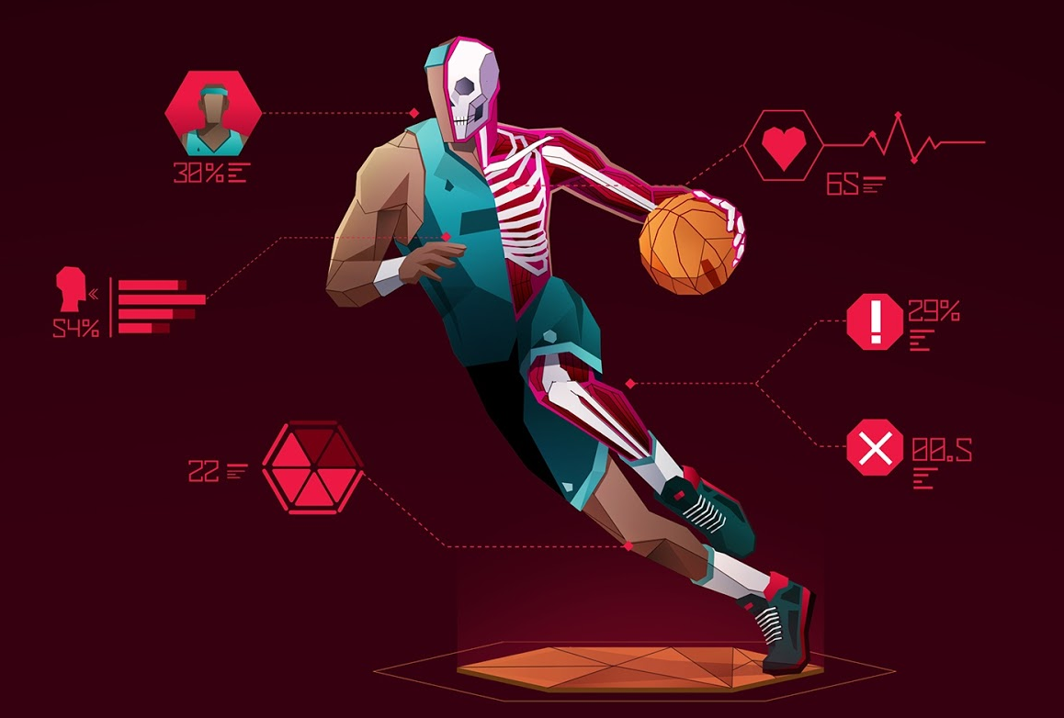
Why Biometrics?
Challenges of pre-NBA performance data
Volume
Variety
Veracity
Growth mindset
Image: basketballzoop.com
Notes:
Jim:
In addition, I wanted to briefly touch on why we’re focused on Biometrics - which for those of you who don’t know, is a just fancy word for physical body measurements and calculation.
This includes the usual suspects like height and weight, but also includes more detailed measurements such as arm length, hand size, body fat percentage, and of course also physical performance statistics like speed in various timed drills and vertical jumping ability.
In general, NBA players are elite athletes. But even in this very highest top percentage of the population there is a wide distribution of characteristics to analyze
We focused here for two main reasons.
Limited quality of data available for statistics
Too much to process, from too many different sources
Player statistics can vary a lot in signaling strength depending on the level of competition
25 ppg in a community college means something different than 25 ppg at a Division I NCAA school like Duke or Syracuse, or playing overseas in Euroleague
Growth mindset regarding player skills
“You can’t teach size”
There are countless examples of players who change their playstyle / improve over time. Practice free throws, work on their 3 point shot, or dunk less as they age
We’ll argue that despite this, biometrics can provide a predictive indicator

Slide 8
Biometrics

Slide 9
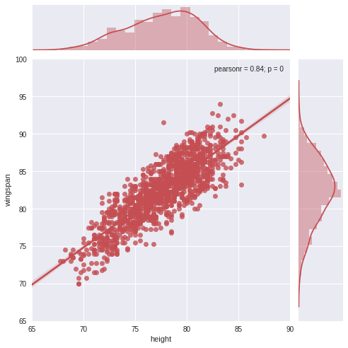

Intro to rex-ratio
Notes:
-Wingspan/Height - the average human has approximately the same height as wingspan, 1:1 ratio

Slide 10
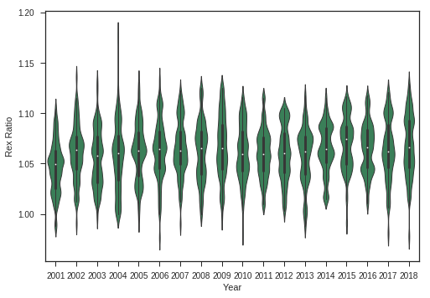
Rex ratio over time
Typical Human
Notes:
-NBA Players have always been “longer” than the average human

Slide 11
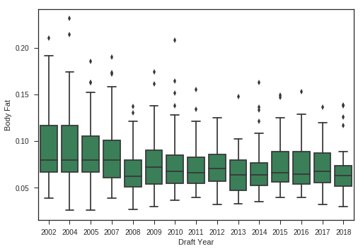
Body fat percentage over time
Notes:
-Range of body fat % has decreased over time
-Pace of play has increased, players need to be leaner and faster

Slide 12
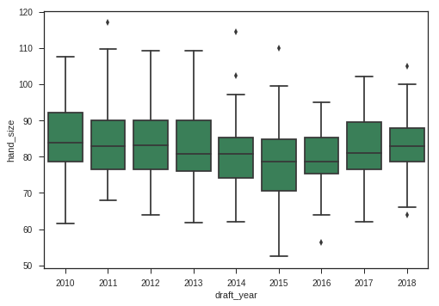
Hand area over time

Slide 13
Player Backgrounds

Slide 14
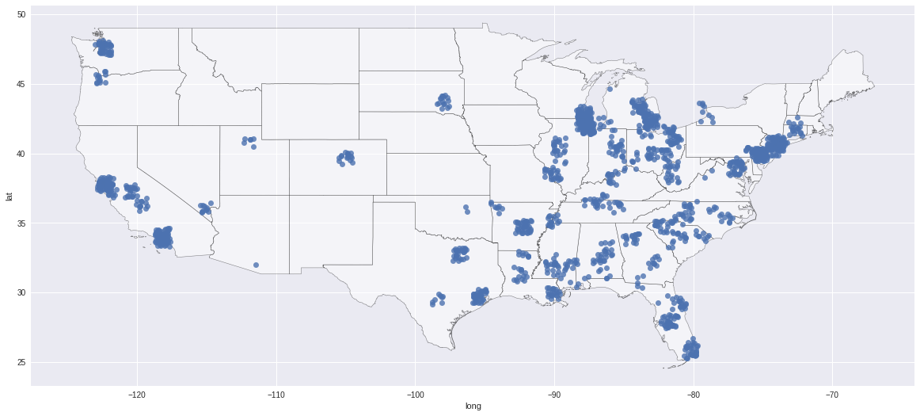
NBA Players’ Hometowns

Slide 15
How has the game evolved?

Slide 16
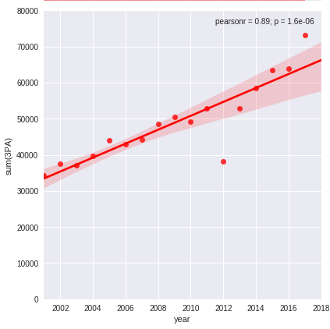
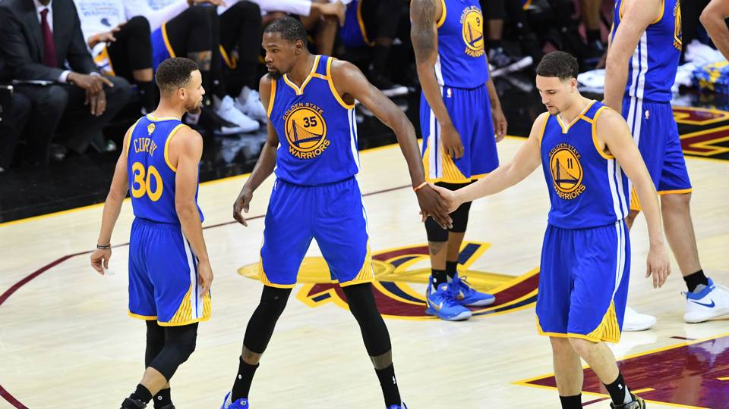
Total 3-Point Attempts by Season
Notes:
3 is more than 2!!!

Slide 17
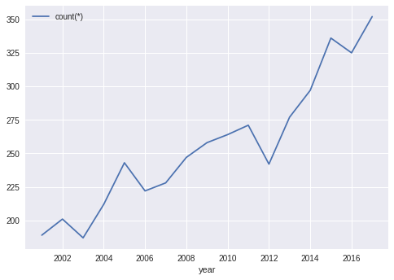
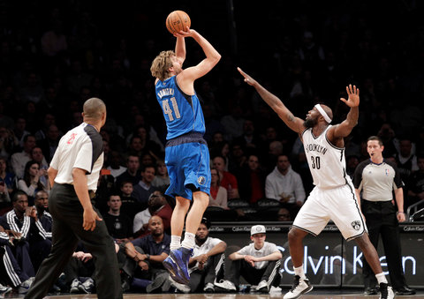
More players are attempting 3 pointers
Notes:
3 is more than 2!!!

Slide 18

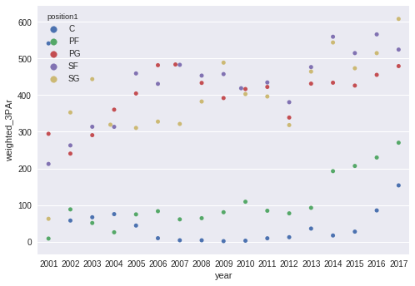
3-Point Attempt Rate by Position
Notes:
-As 3 pointers have become more popular, the fad has picked up across all positions
-”Unicorns”

Slide 19
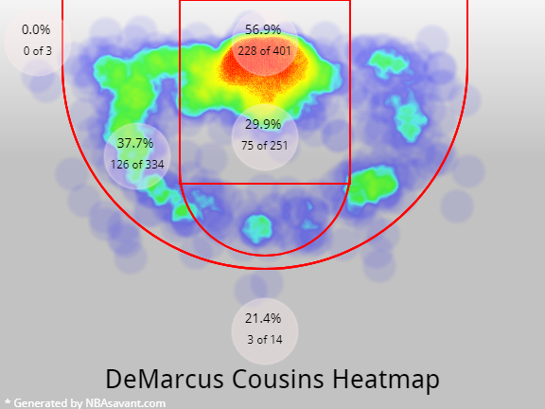
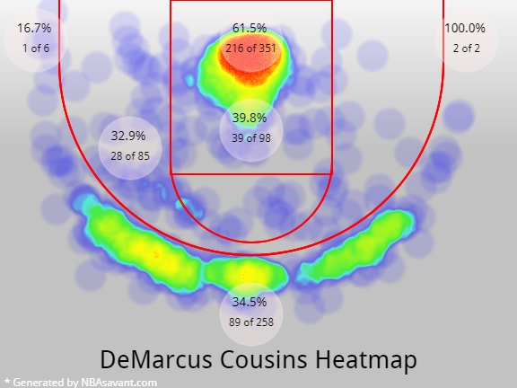
Demarcus Cousins Shot Attempts
2010-2011
2017-2018
Note: Generated by NBASavant.com

Slide 20
Success in the NBA
Notes:
Description of PER
How we arrived at 8-year PER

Slide 21
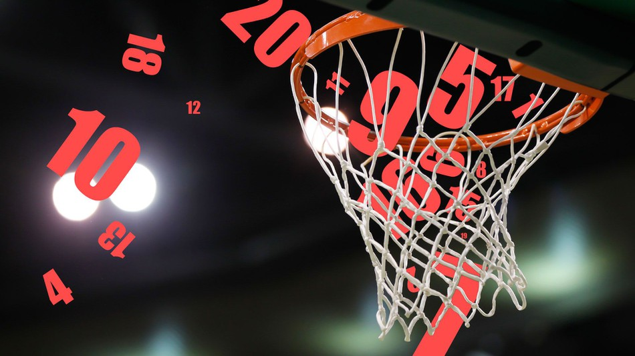
PER
Normalized success metric
Per-minute and pace-adjusted
"The PER sums up all a player's positive accomplishments, subtracts the negative accomplishments, and returns a per-minute rating of a player's performance." -John Hollinger
Source: Basketball-Reference.com
Notes:
*Does not weight defense as heavily as offense
“Average” player is 15

Slide 22
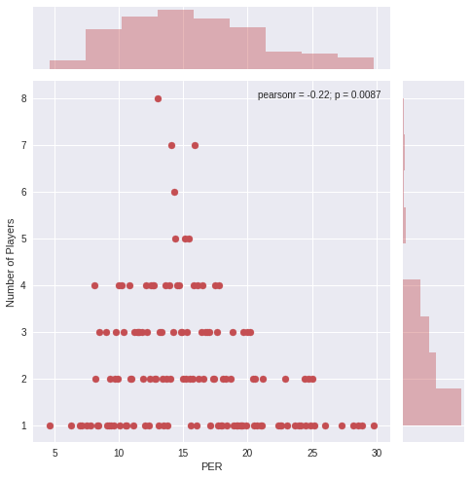
PER distribution in the NBA today (2017-2018)
Most common PER: ~ 14
James Harden
(29.8)
Semi Ojeleye
(4.6)
Notes:
Jim
Min: Semi Ojeleye (BOS): 4.6

Slide 23
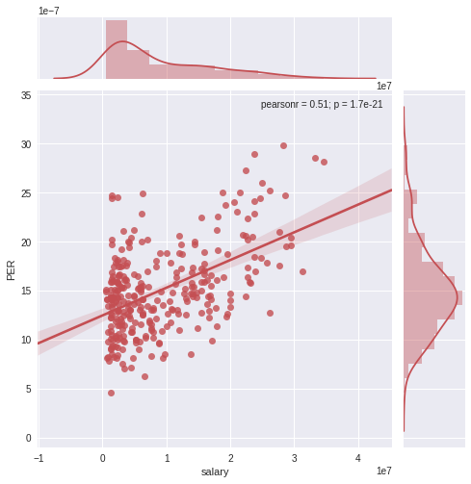
2017-2018 PER vs Salary
Lebron James
Steph Curry
Carmelo Anthony
Semi Ojeleye
Notes:
Jim

Slide 24
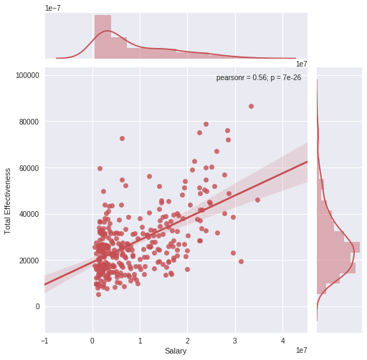
2017-2018 Total Effectiveness vs Salary
Lebron James
Notes:
Jim

Slide 25
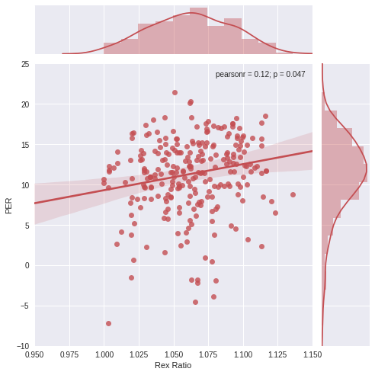
Rex ratio : PER

Slide 26
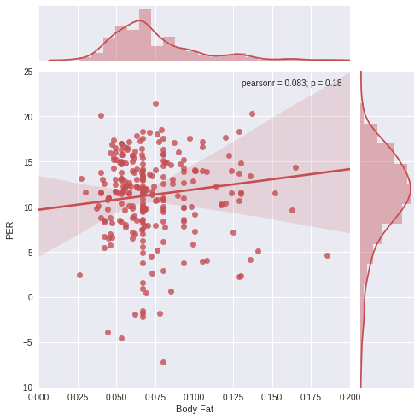
Body fat : PER

Slide 27

Biometrics → Success
Does size of hands impact shooting skills?

Slide 28
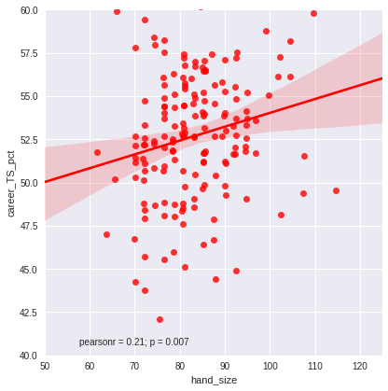
Hand Size vs True Shooting Percentage
Notes:
(Define TS%)
It appears that larger hand size means better True Shooting percentage

Slide 29
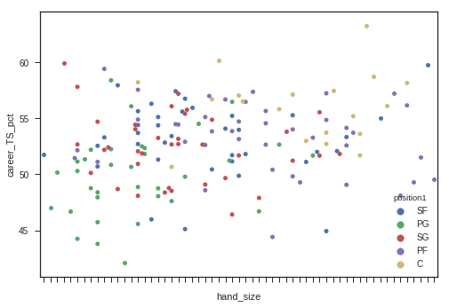
But wait….
Notes:
There appears to be a correlation by position with True Shooting % also.
Hypothesis: Big men will typically attempt higher-percentage shots since they play closer to the rim, leading to a higher shooting percentage
We need to normalize for shot distance and difficulty.
Enter...the free throw

Slide 30
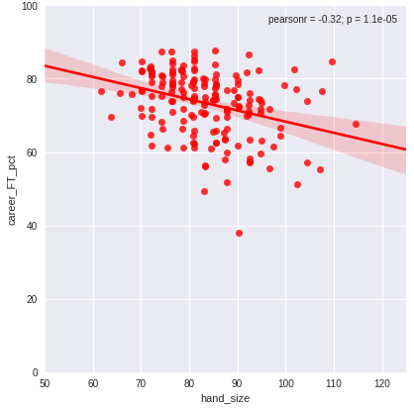
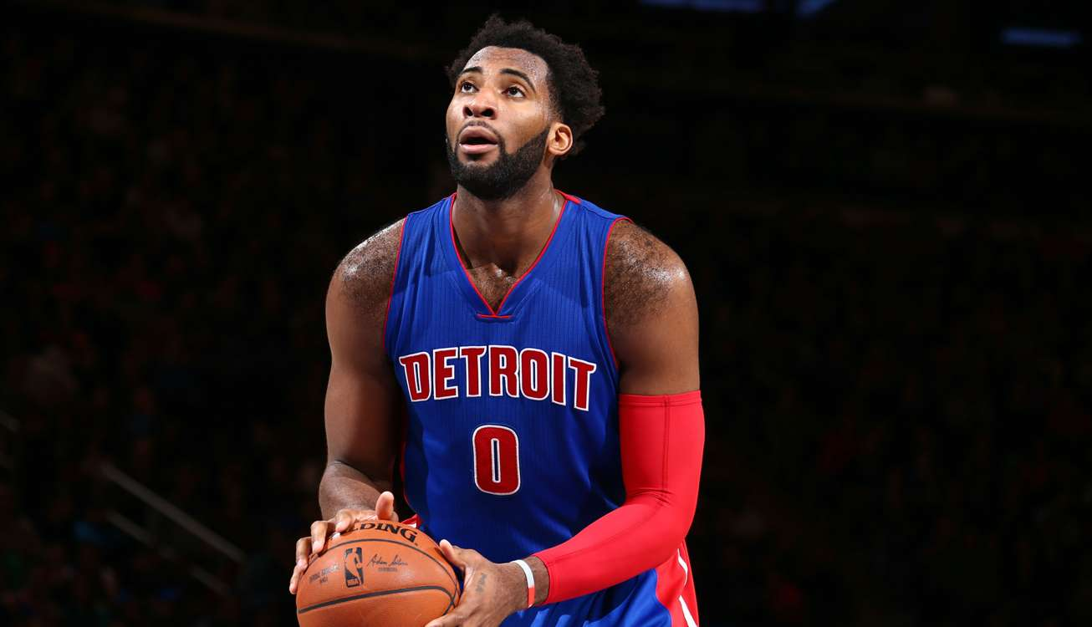
Negative correlation between hand size and free throw percentage!
Notes:
The best shooters will have smaller hands - guards with large hands (rajon rondo) will have more difficulty shooting.

Slide 31
Player backgrounds → Success

Slide 32
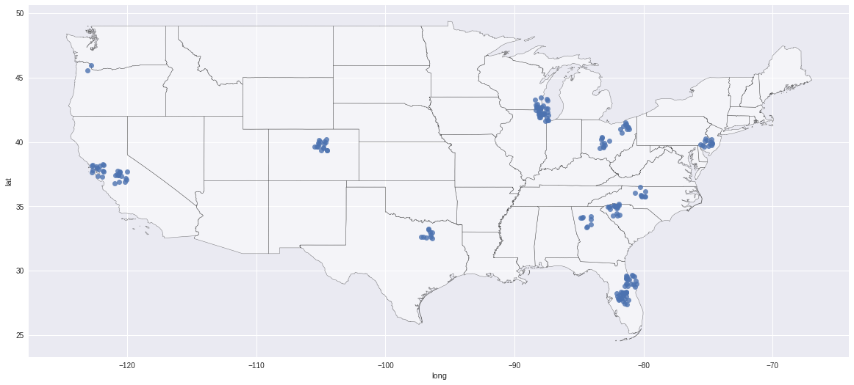
Player backgrounds → Success

Slide 33
Key Takeaways

Slide 34
Predictors of success
Higher rex ratio
+
Smaller hands
+
Urban hometown
+
Power forward & center

Slide 35
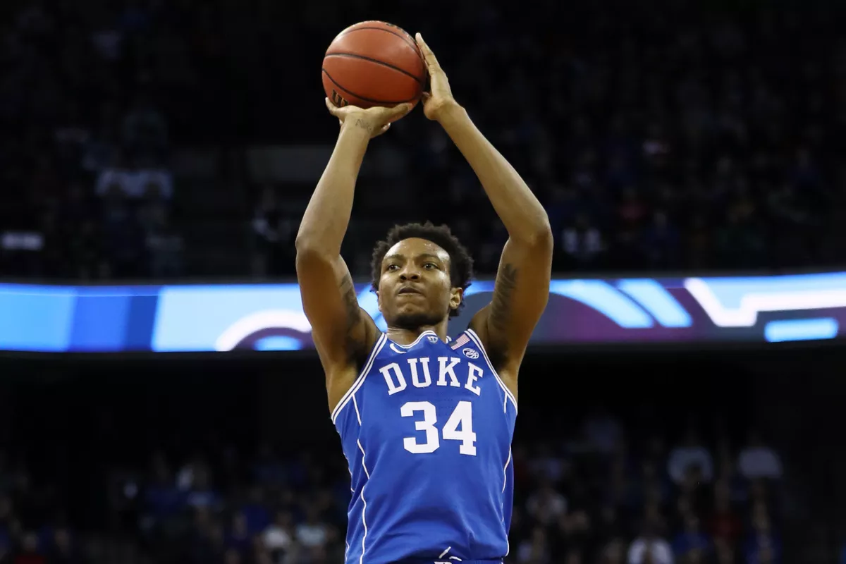
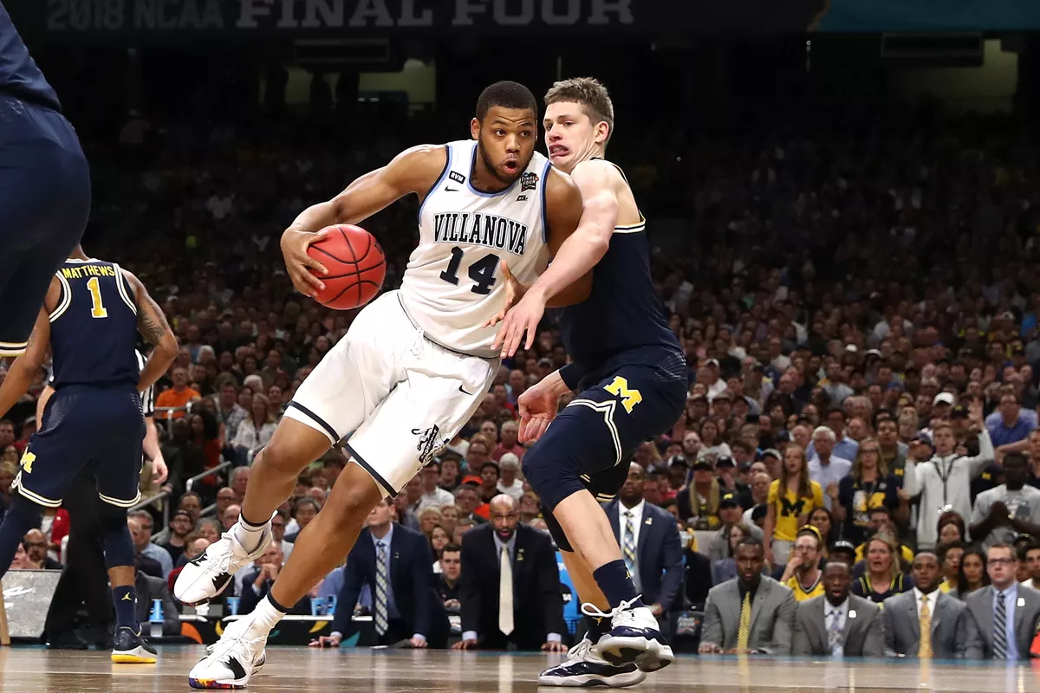
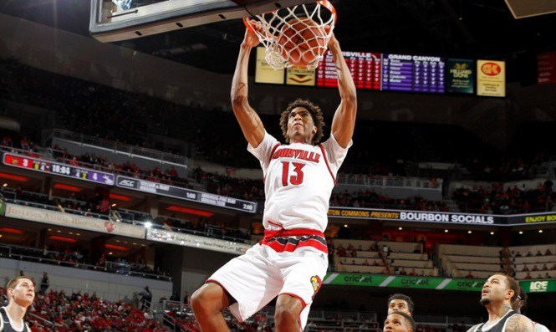
2018 Draft Class PF/C Top 10
Rex Ratio |  |  | Hand Size
Mohamed | Bamba | 1.1091 | Wendell | Carter | 76.5
Austin | Wiley | 1.0854 | Omari | Spellman | 81
PJ | Washington | 1.0812 | Alize | Johnson | 82.875
Udoka | Azubuike | 1.0801 | Jontay | Porter | 83.125
Bruno | Fernando | 1.0795 | Ray | Spalding | 83.25
Wendell | Carter | 1.0793 | Chimezie | Metu | 83.25
Ray | Spalding | 1.079 | Justin | Jackson | 85.5
Jaren | Jackson | 1.0721 | Kostas | Antetokounmpo | 87.875
Omari | Spellman | 1.0585 | Billy | Preston | 87.875
Sagaba | Konate | 1.0566 | PJ | Washington | 92.25

Slide 36
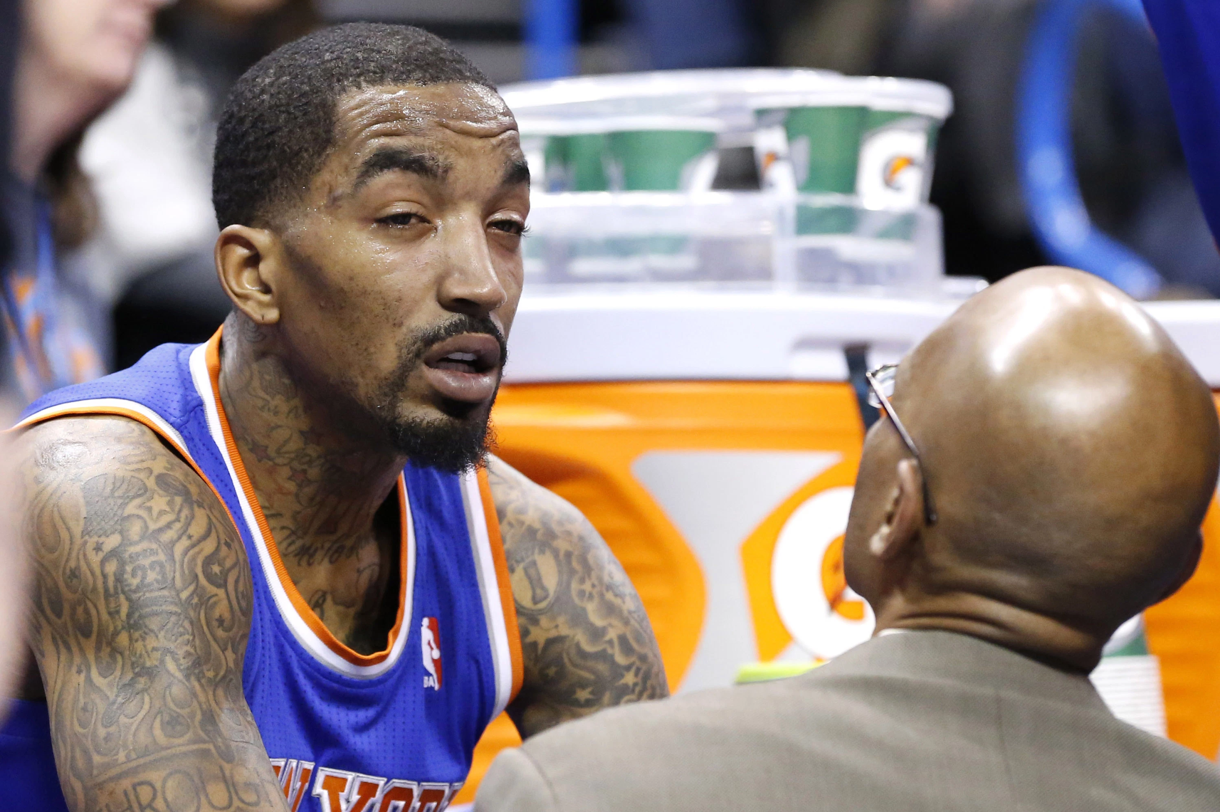
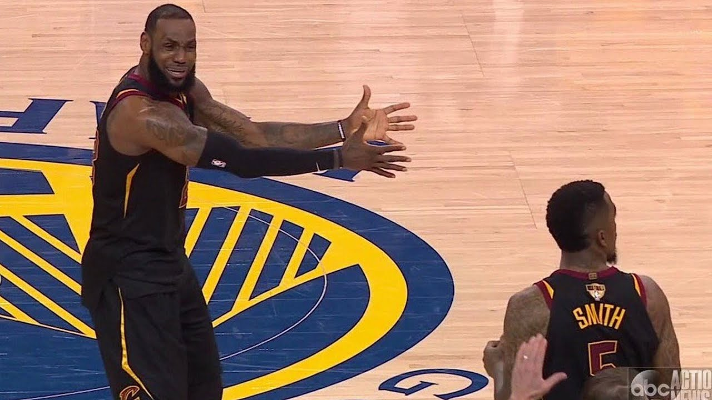
Thank you!
Questions?
Lina Barkawi | Jim Green | Scott Halperin | Matt Krasnoff | Jeff Spielberg

